Slide 1
Synthesis Using AND, OR, and NOT Gates
A factory makes bubble gumballs. The gumballs travel on a conveyor that has three associated sensors s₁, s₂, and s₃. The sensor s₁ is connected to a scale that weighs each gumball, and if a gumball is not heavy enough to be acceptable then the sensor sets s₁ = 1.
Sensors s₂ and s₃ examine the diameter of each gumball. If a gumball is too small to be acceptable, then s₂ = 1, and if it is too large, then s₃ = 1.
If a gumball is of an acceptable weight and size, then the sensors give s₁ = s₂ = s₃ = 0.
The conveyor pushes the gumballs over a “trap door” that it used to reject the ones that are not properly formed.
A gumball should be rejected if it is too large, or both too small and too light. The trap door is opened by setting the logic function f to the value 1.

Slide 2

Synthesis Using AND, OR, and NOT Gates
Step 1 Truth table, Step 2 Obtain the minimized expression for Output
Step 3 Implement using logic gates
How many inputs, Outputs?
Three inputs, one output - s₁, s₂, and s₃, one output f
s₁ s₂ s₃ f
0 0 0 0
0 0 1 1
0 1 0 0
0 1 1 1
1 0 0 0
1 0 1 1
1 1 0 1
1 1 1 1
Cost = 32

Slide 3
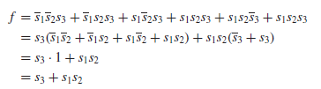
Synthesis Using AND, OR, and NOT Gates
After obtaining the truth table, the logic expression is obtained which has to be minimized.
The cost of a logic circuit is the total number of gates plus the total number of inputs to all gates in the circuit.

Slide 4
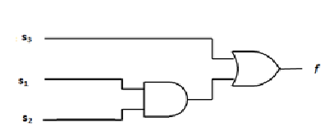
Synthesis Using AND, OR, and NOT Gates
Logic diagram
Cost =6

Slide 5
Sum-of-Products and Product-of-Sums Forms
Multiple ways in which a logic expression can be minimized by using Boolean algebra.
Methods like axioms – theorems, truth table are time consuming, because not clear which rules, identities, and properties should be applied, and in what order.
Hence a graphical technique, called the Karnaugh map for generating a minimal-cost logic will be used.
In a function of n variables, a product term where each of the n variables appears once is called a minterm and a sum term where each of the n variables appears once is called a maxterm.
The variables in a minterm and maxterm can be either in uncomplemented or complemented form. For a given row of the truth table, the minterm is formed by including x_{i} if x_{i} = 1 and if x_{i} = 0 and the maxterm is formed by including x_{i} if x_{i} = 0 and if x_{i} = 1.

Slide 6
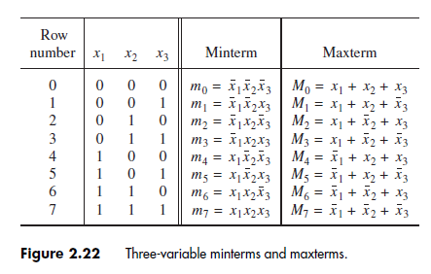
Minterms and Maxterms

Slide 7
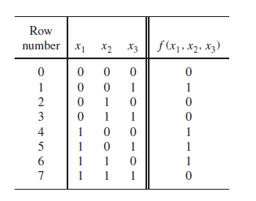



Example
Consider the given Truth table. Any function f can be represented by a sum of minterms that correspond to the rows in the truth table for which f = 1.
A logic expression consisting of product (AND) terms that are summed (ORed) is said to be in the sum-of products (SOP) form.
If each product term is a minterm, then the expression is called a canonical sum-of-products for the function f .

Slide 8
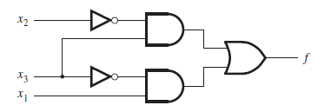
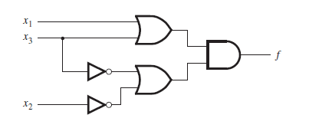
Sum-of-Products and Product-of-Sums Forms
An SOP realization
A POS realization
Cost = 13
Cost = 13

Slide 9

Example
Consider the given Truth table Any function f can be represented by a product of maxterms that correspond to the rows in the truth table for which f = 0.
A logic expression consisting of sum (OR) terms that are the factors of a logical product (AND) is said to be of the product-of-sums (POS) form.
If each sum term is a maxterm, then the expression is called a canonical product-of-sums for the given function.

Slide 10

SoP and PoS
Simplify

Slide 11

SoP and PoS
Simplify
What can you say about the expression f derived from minterms.
What are the Minterms for this expression???
= Σm(2,3,4,6,7)

Slide 12
SoP and PoS
So what do you infer??
Sum of products Σm(2,3,4,6,7) or simply Σ(2,3,4,6,7) in Product of sum form should be
π M(0,1,5) or simply π (0,1,5).
Hence an expression in SoP is equal to its expression in PoS.
F_{SoP} = F_{PoS}
SoP and PoS are not complement of each other but just two different forms of representation of the same function F.

Slide 13
NAND and NOR Logic Networks
The use of AND, OR, and NOT gates in the synthesis of logic circuits have been discussed.
There are other basic logic functions that are also used for this purpose. Particularly useful are the NAND and NOR functions which are obtained by complementing the output generated by AND and OR operations, respectively.
When an expression is in the form of SoP, it is easy to implement he function using( NAND or NOR ??)
NAND gates
When an expression is in the form of PoS, it is easy to implement he function using( NAND or NOR ??)
NOR gates

Slide 14
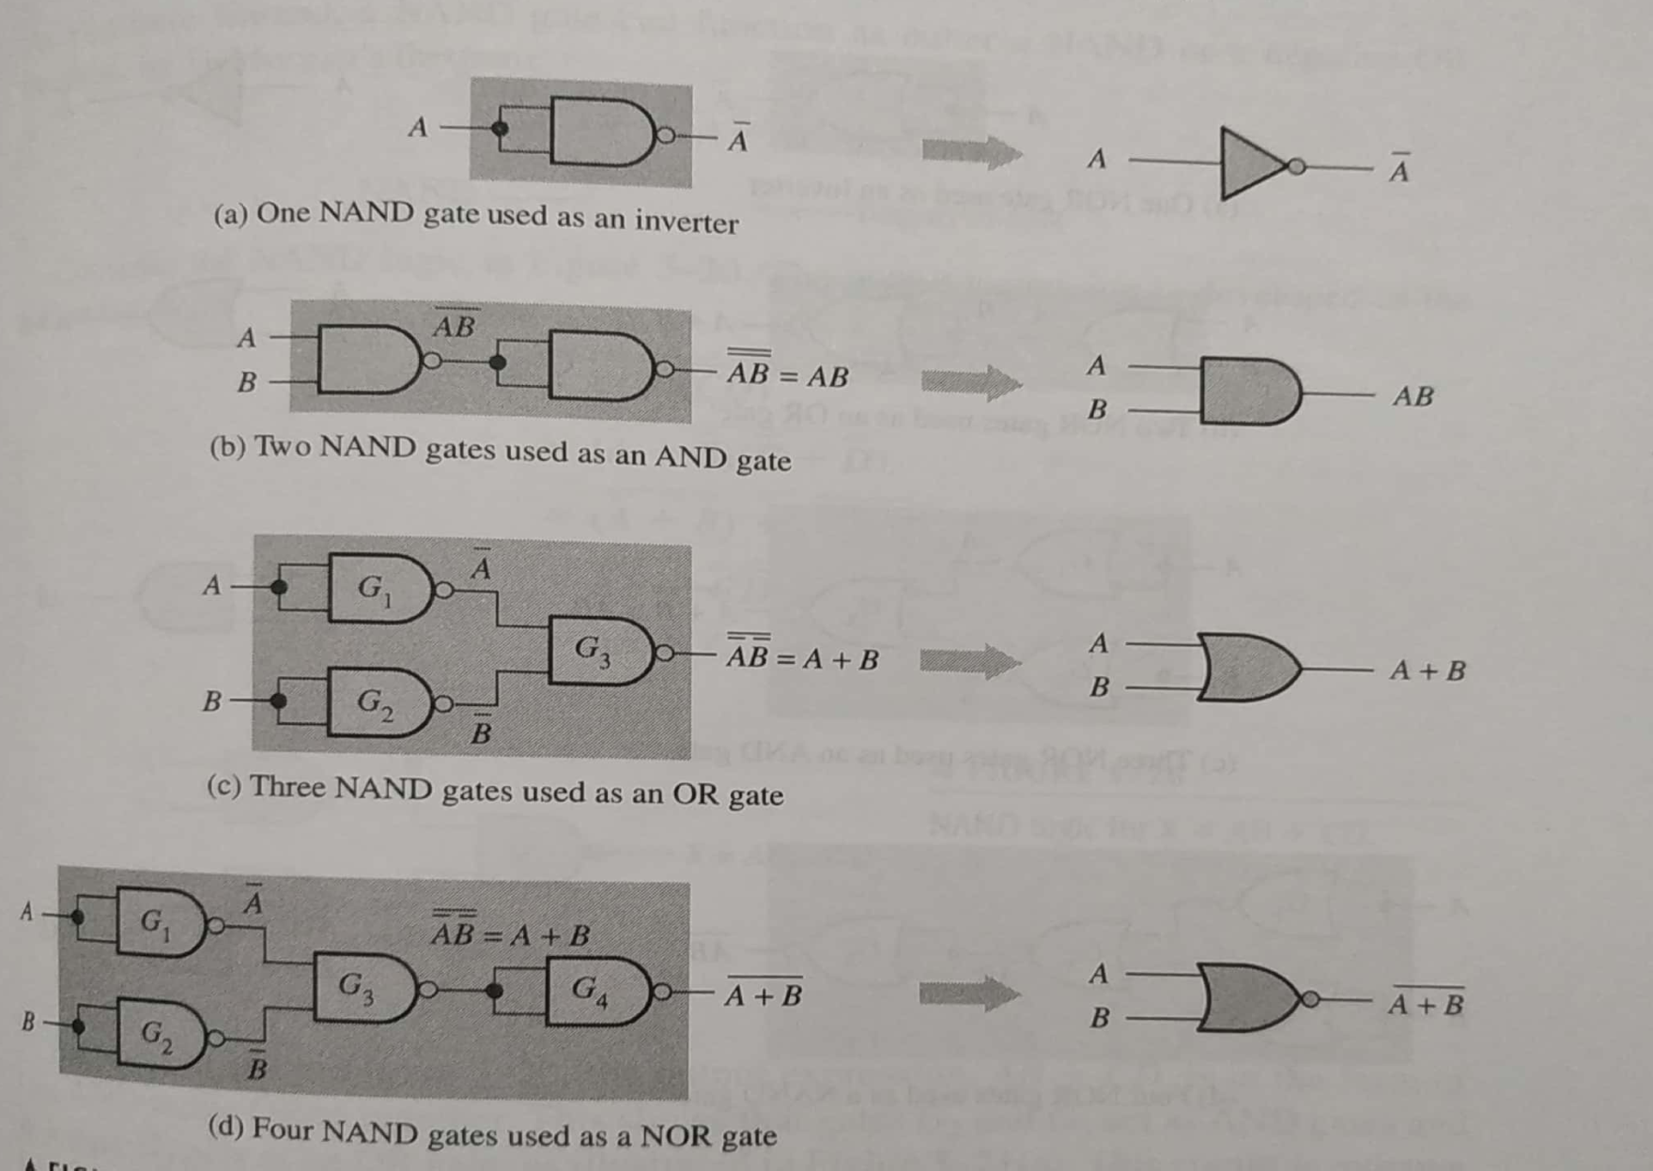
NAND and NOR gates as a Universal gate
A NAND gate is a universal gate because it can be used to produce all basic gates.

Slide 15
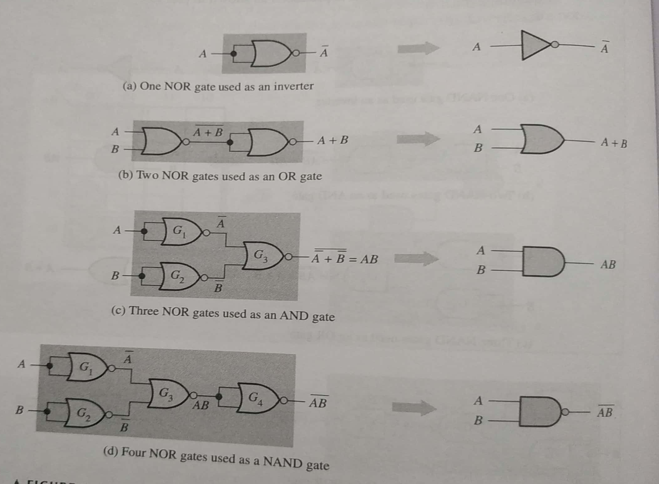
NAND and NOR gates as a Universal gate
A NOR gate is a universal gate because it can be used to produce all basic gates.

Slide 16


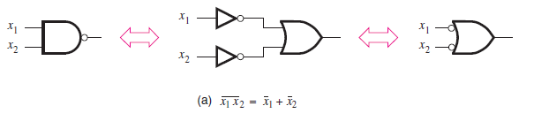
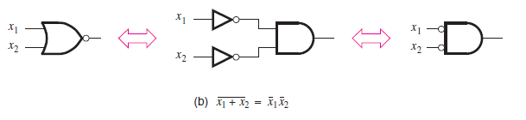
NAND and NOR Logic Networks
DeMorgan’s theorem in terms of logic gates
A NAND gate is equal to a bubbled OR gate
A NOR gate is equal to a bubbled AND gate

Slide 17








NAND and NOR Logic Networks
A NAND gate is equal to a bubbled OR gate
=
A NOR gate is equal to a bubbled AND gate
=
A AND gate is equal to a bubbled NOR gate
=
A OR gate is equal to a bubbled NAND gate
=

Slide 18
AND-OR network into NAND-NAND network
Consider a general AND-OR network. This network can be transformed into a network of NAND gates.
Since double inversion has no effect on the behavior of the network, each connection between the AND gate and an OR gate is replaced by a connection that includes two inversions of the signal: one inversion at the output of the AND gate and the other at the input of the OR gate.
The OR gate with inversions at its inputs is equivalent to a NAND gate.
Hence we can redraw the network using only NAND gates.
This example shows that any AND-OR network can be implemented as a NAND-NAND network having the same topology

Slide 19
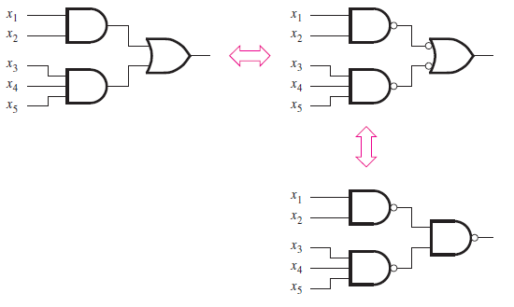
NAND gates to implement an SoP

Slide 20
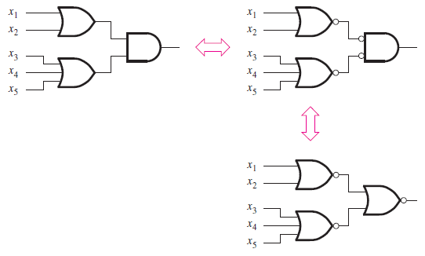
OR-AND network into NOR-NOR network
Consider a general OR-AND network. This network can be transformed into a network of NOR gates.

Slide 21
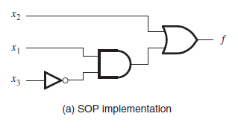
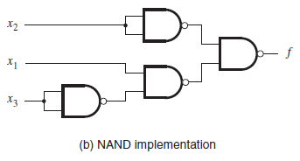
NAND and NOR Logic Networks
Implement the function using NAND gates only
To implement using NAND gates only , the function should be in --------.

Slide 22
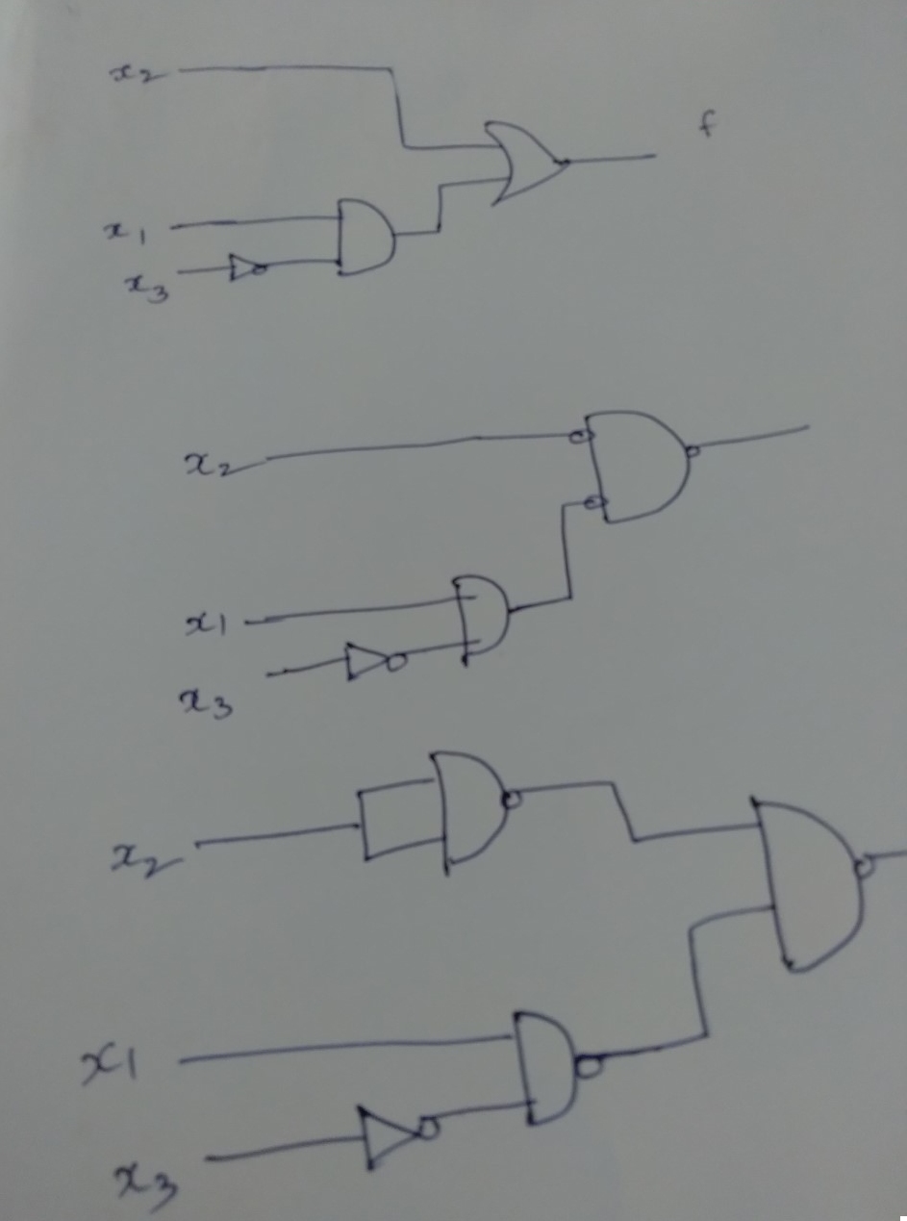

Slide 23
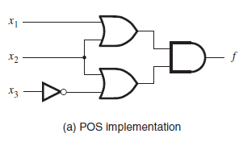
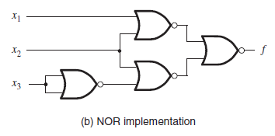
NAND and NOR Logic Networks
Implement the function using NOR gates only
To implement using NOR gates only , the function should be in --------.

